Slide 1


Normalization, Standardization

Slide 2
Learning Objectives
At the end of the lesson participate should be able to:
Understand the concept of scaling in data science.
Describe the concept of feature scaling and normalization.
Explain the need for scaling in the first place.
Know when to scale a particular data.
Know some examples of scaling algorithm.
Know some algorithm that don’t need data scaling.
Select some appropriate scaling algorithm for data preparation.

Slide 3
Introduction
Before discussing the different type of scaling, it’s why, when and how there is the need to know why rescaling of data in the first place.
Machine learning is like making a mixed fruit juice. If we want to get the best-mixed juice, we need to mix all fruit not by their size but based on their right proportion. We just need to remember apple and strawberry are not the same unless we make them similar in some context to compare their attribute. Similarly, in many machine learning algorithms, to bring all features in the same standing, we need to do scaling so that one significant number doesn’t impact the model just because of their large magnitude.

Slide 4
Feature Scaling
Feature scaling in machine learning is one of the most critical steps during the pre-processing of data before creating a machine learning model. Scaling can make a difference between a weak machine learning model and a better one.

Slide 5
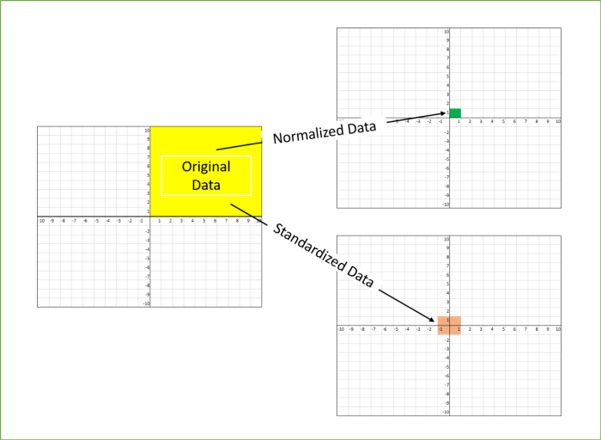
Normalization
Normalization is used when we want to bound our values between two numbers, typically, between [0,1] or [-1,1]. While Standardization transforms the data to have zero mean and a variance of 1, they make our data unitless. The graph below shows how data looks after scaling in the X-Y plane.

Slide 6
Why do we need scaling?
For our Machine learning algorithm all it’s sees is number — if for instance there is a vast difference in the range say few ranging in thousands and few ranging in the tens, and it makes the underlying assumption that higher ranging numbers have superiority of some sort. So these more significant number starts playing a more decisive role while training the model which at the end will result in biases of the model.
The machine learning algorithm works on numbers and does not know what that number represents. A weight of 10 grams and a price of 10 dollars represents completely two different things — which is a no brainer for humans, but for a model as a feature, it treats both as same.

Slide 7
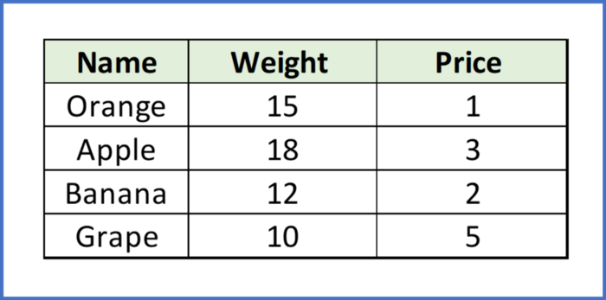
Why do we need scaling?
Suppose we have two features of weight and price, as in the below table. The “Weight” cannot have a meaningful comparison with the “Price.” So the assumption algorithm makes that since “Weight” > “Price,” thus “Weight,” is more important than “Price.”

Slide 8
Why do we need scaling?
So these more significant number starts playing a more decisive role while training the model. Thus feature scaling is needed to bring every feature in the same footing without any upfront importance. Interestingly, if we convert the weight to “Kg,” then “Price” becomes dominant.
Another reason why feature scaling is applied is that few algorithms like Neural network gradient descent converge much faster with feature scaling than without it.

Slide 9
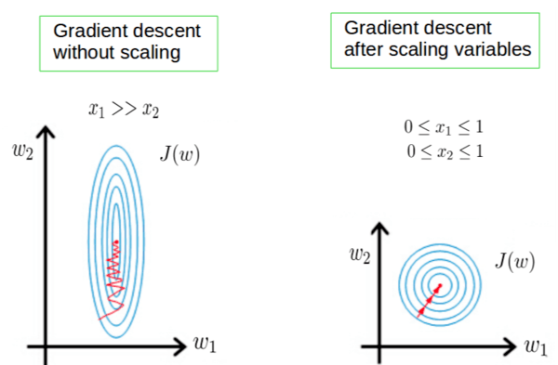
Why do we need scaling?
One more reason is saturation, like in the case of sigmoid activation in Neural Network, scaling would help not to saturate too fast.

Slide 10
When to Scale Datasets
Feature scaling is essential for machine learning algorithms that calculate distances between data. If not scale, the feature with a higher value range starts dominating when calculating distances, as explained intuitively in the “why?” section.
The ML algorithm is sensitive to the “relative scales of features,” which usually happens when it uses the numeric values of the features rather than say their rank.
In many algorithms, when we desire faster convergence, scaling is a MUST like in Neural Network.
Since the range of values of raw data varies widely, in some machine learning algorithms, objective functions do not work correctly without normalization. For example, the majority of classifiers calculate the distance between two points by the distance. If one of the features has a broad range of values, the distance governs this particular feature. Therefore, the range of all features should be normalized so that each feature contributes approximately proportionately to the final distance.

Slide 11
When to Scale Datasets
Even when the conditions, as mentioned above, are not satisfied, you may still need to rescale your features if the ML algorithm expects some scale or a saturation phenomenon can happen. Again, a neural network with saturating activation functions (e.g., sigmoid) is a good example.
Rule of thumb we may follow here is an algorithm that computes distance or assumes normality, scales your features.

Slide 12
Examples of Models
Some examples of models where feature scaling matter are:
K-nearest neighbors (KNN) with a Euclidean distance measure is sensitive to magnitudes and hence should be scaled for all features to weigh in equally.
K-Means uses the Euclidean distance measure here feature scaling matters.
Scaling is critical while performing Principal Component Analysis(PCA). PCA tries to get the features with maximum variance, and the variance is high for high magnitude features and skews the PCA towards high magnitude features.
We can speed up gradient descent by scaling because θ descends quickly on small ranges and slowly on large ranges, and oscillates inefficiently down to the optimum when the variables are very uneven.

Slide 13
Algorithm for Scaling
Algorithms that do not require normalization/scaling are the ones that rely on rules. They would not be affected by any monotonic transformations of the variables. Scaling is a monotonic transformation. Examples of algorithms in this category are all the tree-based algorithms — CART, Random Forests, Gradient Boosted Decision Trees. These algorithms utilize rules (series of inequalities) and do not require normalization.

Slide 14
Algorithm that can Handle Scaling
Algorithms like Linear Discriminant Analysis(LDA), Naive Bayes is by design equipped to handle this and give weights to the features accordingly. Performing features scaling in these algorithms may not have much effect.
Few key points to note :
Mean centering does not affect the covariance matrix
Scaling of variables does affect the covariance matrix
Standardizing affects the covariance

Slide 15
Algorithm that can Handle Scaling
Below are the few ways we can do feature scaling.
1) Min Max Scaler
2) Standard Scaler
3) Max Abs Scaler
4) Robust Scaler
5) Quantile Transformer Scaler
6) Power Transformer Scaler
7) Unit Vector Scaler
8)Log Transformer

Slide 16

MinMax Scaler
Transform features by scaling each feature to a given range. This estimator scales and translates each feature individually such that it is in the given range on the training set, e.g., between zero and one. This Scaler shrinks the data within the range of -1 to 1 if there are negative values. We can set the range like [0,1] or [0,5] or [-1,1].
This Scaler responds well if the standard deviation is small and when a distribution is not Gaussian. This Scaler is sensitive to outliers.

Slide 17

Standard Scaler
The Standard Scaler assumes data is normally distributed within each feature and scales them such that the distribution centered around 0, with a standard deviation of 1.
Centering and scaling happen independently on each feature by computing the relevant statistics on the samples in the training set. If data is not normally distributed, this is not the best Scaler to use.

Slide 18
Log Transformation
Log transformation is a data transformation method in which it replaces each variable x with a log(x). The choice of the logarithm base is usually left up to the analyst and it would depend on the purposes of statistical modeling. In this article, we will focus on the natural log transformation. The nature log is denoted as ln.
When our original continuous data do not follow the bell curve, we can log transform this data to make it as “normal” as possible so that the statistical analysis results from this data become more valid. In other words, the log transformation reduces or removes the skewness of our original data. The important caveat here is that the original data has to follow or approximately follow a log-normal distribution. Otherwise, the log transformation won’t work.

Slide 19
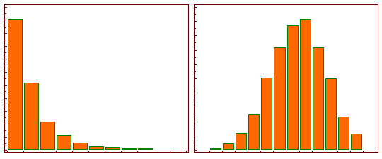
What is Log Transformation

Slide 20
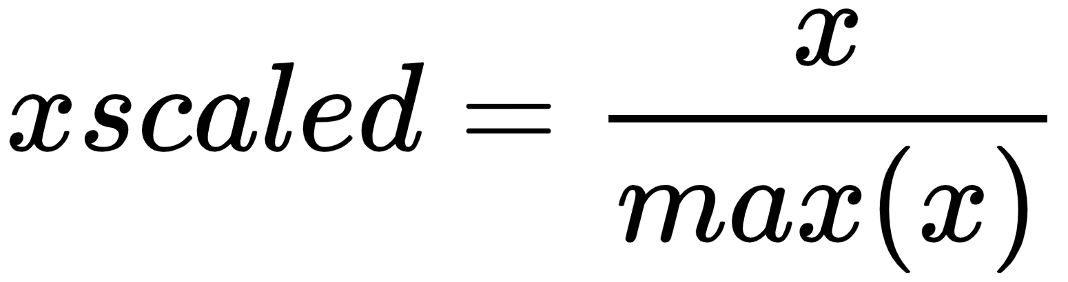
Max Absolute Scaler
Maximum absolute scaling scales the data to its maximum value, dividing each observation by the variable's maximum value.
MaxAbsScaler is similar to MinMaxScaler in that the values are mapped across several ranges depending on whether they are negative or positive. The range is [0, 1] if only positive values are present. The range is [-1, 0] if only negative values are present. The range is [-1, 1] if both negative and positive values are present. MinMaxScaler and MaxAbsScaler behave similarly on only positive data. As a result, MaxAbsScaler suffers from the presence of large outliers.
The result of the preceding transformation is a distribution in which the values vary approximately within the range of -1 to 1.

Slide 21
Power Transformer Scaler
Power transformers are a class of parametric, linear transformations used to make data more Gaussian. This is useful for modeling heteroscedasticity (variance that is not constant) or other situations where normality is desired.
Power Transformer currently supports the Box-Cox and Yeo-Johnson transforms. Maximum likelihood is used to determine the best parameter for minimizing skewness and stabilizing variance.
Box-Cox requires only positive input data, whereas Yeo-Johnson accepts both positive and negative data.
The transformed data is normalized using zero-mean, unit-variance normalization.

Slide 22
When to use power transformations
Power transformations are useful when using distance-based models such as KNN, K-means, and DBSCAN. They are said to be useful with linear models and gaussian Naive Bayes. Models based on trees and neural networks are unaffected by feature symmetry, whereas SVM may require a power transformation in advance if we only need to work with linear kernels.

Slide 23
Similarities Measures
Similarity or distance measures are core components used by distance-based clustering algorithms to cluster similar data points into the same clusters, while dissimilar or distant data points are placed into different clusters.

Slide 24
Why Similarities Measures
Distance or similarity measures are essential in solving many pattern recognition problems such as classification and clustering. Various distance/similarity measures are available in the literature to compare two data distributions. As the names suggest, a similarity measures how close two distributions are.

Slide 25
Application of Similarity Measures
Many real-world applications use similarity measures to determine how two objects are related. These measures can be used in applications involving computer vision and natural language processing, such as finding and mapping similar documents. An important use case would be to segment different customers for marketing campaigns using the K-Means Clustering algorithm which also uses similarity measures.
Example: A Resource Manager put out a vacant application position and the total number of applicant is 1000, and also, the vacant position available, is meant just for 10 people. So in other to save time and get the candidate that matches the job description, we use the clustering which is backed by the similarity measures.

Slide 26
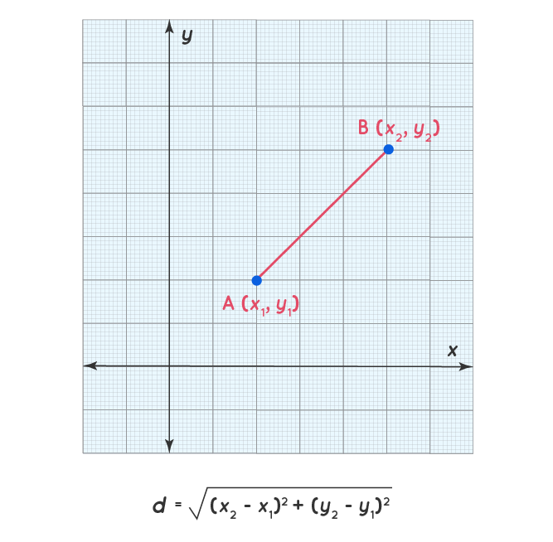
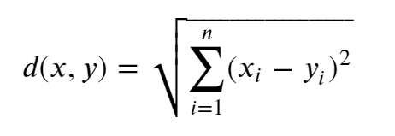
Types of Similarity Measures
Euclidean distance: is the distance between two points. In other words, the length of a line segment connecting two points in euclidean space. It helps to find the distance of a line segment. If we assume two points A(x1,y1) and B(x2,y2), then the Euclidean distance is shown in the graph below. This is also called straight line distance.

Slide 27
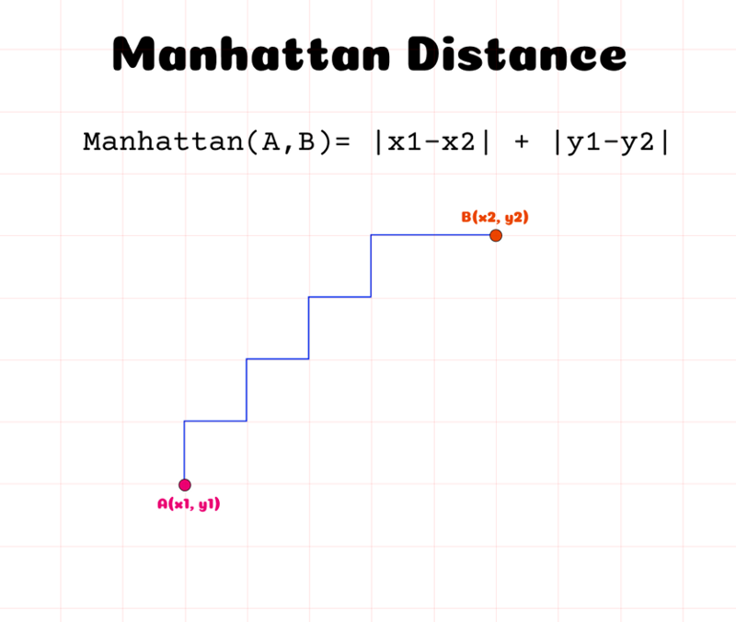

Manhattan Distance
The Manhattan distance is a metric for measuring the distance between two points in an N-dimensional vector space. It is the sum of the lengths of the line segment projections between the points onto the coordinate axes. In simple terms, it is the sum of the absolute differences between the measurements of two points in all dimensions. It can also be refer to as Taxicab or City Block Distance.

Slide 28
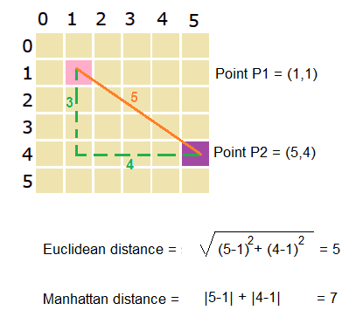
Difference Between Euclidean and Manhattan Distance
Manhattan distance captures the distance between two points by aggregating the pairwise absolute difference between each variable while Euclidean distance captures the same by aggregating the squared difference in each variable.

Slide 29
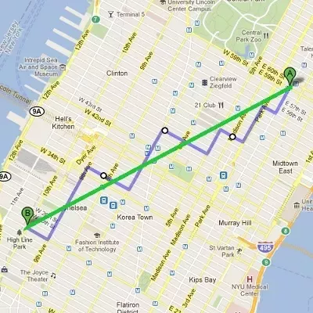
Euclidean and Manhattan Distance Illustrations using Map

Slide 30
Hamming Distance
Hamming distance is a metric for comparing two binary data strings. While comparing two binary strings of equal length, Hamming distance is the number of bit positions in which the two bits are different. It is used for error detection or error correction when data is transmitted over computer networks. It is also using in coding theory for comparing equal length data words.
Example: Suppose there are two strings 1101 1001 and 1001 1101.
11011001 ⊕ 10011101 = 01000100. Since, this contains two 1s, the Hamming distance, d(11011001, 10011101) = 2.
Minimum Hamming Distance
In a set of strings of equal lengths, the minimum Hamming distance is the smallest Hamming distance between all possible pairs of strings in that set.
Example
Suppose there are four strings 010, 011, 101 and 111.
010 ⊕ 011 = 001, d(010, 011) = 1.
010 ⊕ 101 = 111, d(010, 101) = 3.
010 ⊕ 111 = 101, d(010, 111) = 2.

Slide 31
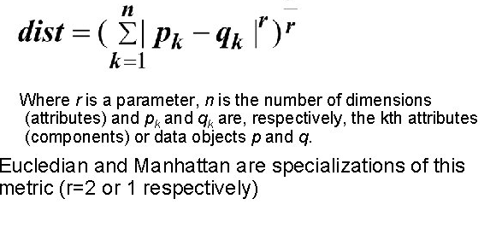
Minkowski Distance
Minkowski distance is a distance measured between two points in N-dimensional space. It is basically a generalization of the Euclidean distance and the Manhattan distance. It is widely used in the field of Machine learning, especially in the concept to find the optimal correlation or classification of data. Minkowski distance is used in certain algorithms also like K-Nearest Neighbors, Learning Vector Quantization (LVQ), Self-Organizing Map (SOM), and K-Means Clustering.

Slide 32
Example
Given two list of numbers vect1 as (4, 2, 6, 8) and vect2 as (5, 1, 7, 9). What is the minkowski distance.
( |4 – 5|2 + |2 – 1|2 + |6 – 7|2 + |8 – 9|2 )1/2

Slide 33
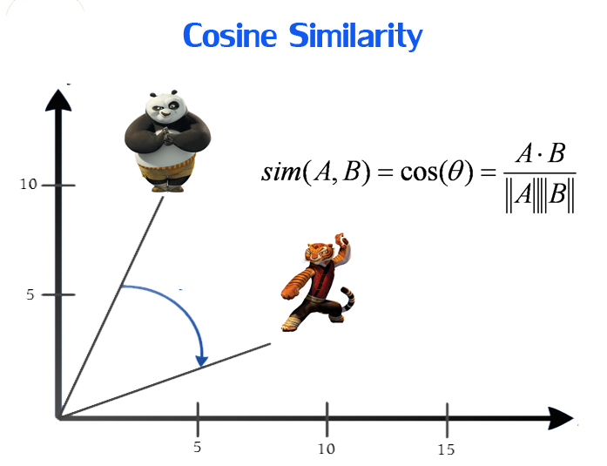
Cosine Similarity
“Cosine similarity measures the similarity between two vectors of an inner product space. It is measured by the cosine of the angle between two vectors and determines whether two vectors are pointing in roughly the same direction. It is often used to measure document similarity in text analysis” (Jiawei Han, ... Jian Pei).
Cosine similarity is a measure of similarity that can be used to compare documents or, say, give a ranking of documents with respect to a given vector of query words. Let x and y be two vectors for comparison.

Slide 34
Cosine Similarity
The similarity can take values between -1 and +1. Smaller angles between vectors produce larger cosine values, indicating greater cosine similarity. For example:
When two vectors have the same orientation, the angle between them is 0, and the cosine similarity is 1.
Perpendicular vectors have a 90-degree angle between them and a cosine similarity of 0.
Opposite vectors have an angle of 180 degrees between them and a cosine similarity of -1.

Slide 35
Application of Cosine
Cosine Similarity is widely used in Data Science and Machine Learning applications. Examples include measuring the similarity of:
Documents in natural language processing
Movies, books, videos, or users in recommendation systems
Images in computer vision.
Example
Suppose that our goal is to calculate the cosine similarity of the two documents given below.
Document 1 = 'the best data science course'
Document 2 = 'data science is popular'
After creating a word table from the documents, the documents can be represented by the following vectors:
D1 = [1, 1, 1, 1, 1, 0, 0]
D2 = [0, 0, 1, 1, 0, 1, 1]

Slide 36
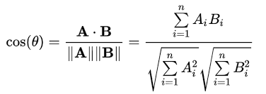
Continuation
Using these two vectors we can calculate cosine similarity. First, we calculate the dot product of the vectors:
D1.D2 = 1*0+1*0+1*1+1*1+1*0+0*1+0*1 = 2
Second, we calculate the magnitude of the vectors:
D2 = sqrt([0^2 + 0^2 + 1^2 + 1^2 + 0^2 + 1^2 + 1^2])
D1 = sqrt([1^2 + 1^2 + 1^2 + 1^2 + 1^2 + 0^2 + 0^2])
The angle between the vectors is calculated as:
cos(0) = 0.44721
0 = arccos(0.44721)
0 = 63.435

Slide 37
Exercise
What is the similarity between the following set of documents:
Document1 = “The students are all interested in the class despite the fact some of the terms are new”
Document2 = “The course is new and quite interesting so everybody wants to understand the basics”
Assuming you intend moving from sabo yaba to victoria island and you have two route:
routeA = [23, 10, 12, 24]
routeB = [45, 16, 18, 88]
What is the best and optimal route to follow to get to your destination quickly?

Slide 38


